Slide 1
PHYS 304: Lecture 18 (Intro to) Quantum Mechanics
Sept-Dec 2021 Edition
Jeff Young
brimacombe Rm 278, young@phas.ubc.ca

Slide 2
Review of key points from last lecture
The uncertainty principle that involves the product of the variances of two observable quantities is quite distinct from the “Energy-time” uncertainty principle. (time is not an observable)
If two observable operators commute, then the lower limit on the product of their variances is zero. The product of the two variances can in fact be made equal to, or arbitrarily close to zero by putting the system into one of the shared eigen states that the commuting operators must share.
If two observables do not commute, then the more you try to engineer a state with a small variance in one observable, the wider is the minimum variance in the non-commuting observable. This can be understood qualitatively when one thinks of having to express one eigen state in one basis in terms of many eigen states of another.

Slide 3
Review of key points from last lecture
If one of the two observables is the Hamiltonian (total energy), then the commutator on the right hand side is directly related to the time derivative of the expectation value of the other observable in the state being studied. This provides a useful connection to the “Energy-time” uncertainty principle, as the variance of the other observable, divided by the time derivative of its expectation value, defines a time called Δt, that is a measure of how quickly the other parameter can change by its standard deviation (effectively how quickly there would be some observable change in that observable quantity, in that particular state).
So long as even one system observable is changing “rapidly” for a state at some time, then necessarily there is a proportionate uncertainty in the energy one would measure for that state at that time. Conversely, if the energy of the system has a very small variance at some time, then no other observable can be changing “rapidly” at that time.

Slide 4
Today
Finish off discussion of the uncertainty relations and end chapter 3.
Begin our treatment of particle dynamics in three dimensions.

Slide 5

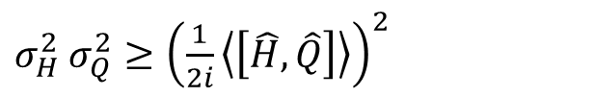

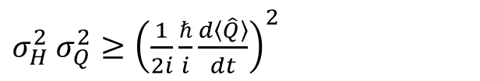
Recall
$$\frac{d}{dt}\left\langle \hat{Q}\right\rangle =\frac{i}{ℏ}\left\langle \left[\hat{H}, \hat{Q}\right]\right\rangle$$
$σ_{H}^{2}$ $σ_{Q}^{2}≥{\left(\frac{1}{2i}\left\langle \left[\hat{H}, \hat{Q}\right]\right\rangle \right)}^{2}$
together with
imply
$σ_{H}^{2}$ $σ_{Q}^{2}≥{\left(\frac{1}{2i}\frac{ℏ}{i}\frac{d\left\langle \hat{Q}\right\rangle }{dt}\right)}^{2}$
$$σ_{H}σ_{Q}≥ℏ/2 |d⟨\hat{Q} ⟩/dt)|$$

Slide 6

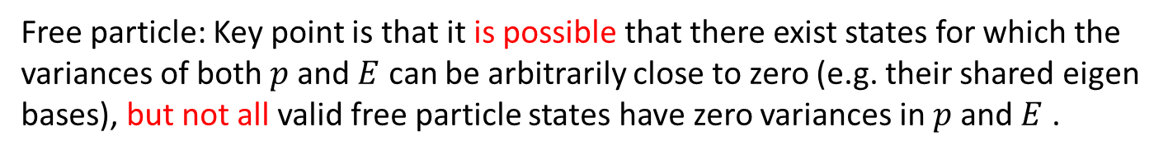
Reflect on our results comparing $σ_{p}^{2}σ_{E}^{2}$for free particles and for particles in a harmonic potential:
For a particle in a harmonic potential: $σ_{p}^{2}σ_{E}^{2}≥\frac{ℏ^{2}}{4}k^{2}{\left\langle \hat{x}\right\rangle }^{2}(t)$.
As deduced from the generalized uncertainty relation
For a free particle: $σ_{p}^{2}σ_{E}^{2}≥0.$
Free particle: Key point is that it is possible that there exist states for which the variances of both $p$and $E$ can be arbitrarily close to zero (e.g. their shared eigen bases), but not all valid free particle states have zero variances in $p$and $E$ .
Harmonic oscillator: key points are that,
Product of variances is state dependent, and in general not equal to zero (consistent with not sharing common eigen states)
Since this product is state dependent, it is also in general time-dependent
Beyond this, not so easy to interpret from the generalized uncertainty relation alone
Notes:
Key points are that is
state dependent, and therefore in general time-dependent
in general not equal to zero (consistent with not sharing common eigen states)
Beyond this, not so easy to interpret

Slide 7
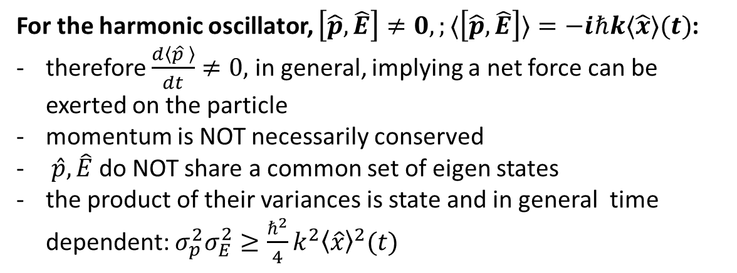
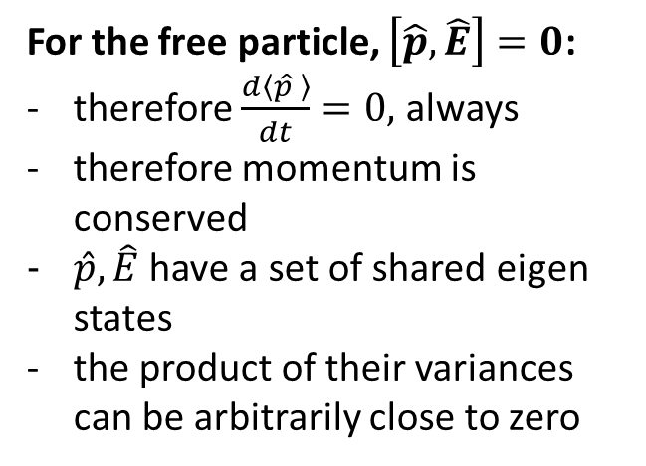

Discuss:
Does the energy-time analysis of the product of variances add any useful insight to this comparison of the free particle and the oscillator results for $σ_{p}σ_{H}$?
$$σ_{p}σ_{H}≡σ_{p}σ_{E}≥ℏ/2 |d⟨\hat{p} ⟩/dt)|$$
For the free particle, $\left[\hat{p},\hat{E}\right]=0$:
therefore $\frac{d\left\langle \hat{p} \right\rangle }{dt}=0,$ always
therefore momentum is conserved
$\hat{p},\hat{E}$ have a set of shared eigen states
the product of their variances can be arbitrarily close to zero
For the harmonic oscillator, $\left[\hat{p},\hat{E}\right]≠0,;⟨\left[\hat{p},\hat{E}\right]⟩=−iℏk⟨\hat{x}⟩(t)$:
therefore $\frac{d\left\langle \hat{p} \right\rangle }{dt}≠0,$ in general, implying a net force can be exerted on the particle
momentum is NOT necessarily conserved
$\hat{p},\hat{E}$do NOT share a common set of eigen states
the product of their variances is state and in general time dependent: $σ_{p}^{2}σ_{E}^{2}≥\frac{ℏ^{2}}{4}k^{2}{\left\langle \hat{x}\right\rangle }^{2}(t)$
Notes:
If momentum is changing rapidly (relative to variance of momentum), then this implies that there must be quite a bit of uncertainty in measurements of the energy at that time.
Think through for a wavepacket that mimics the classical motion of a particle in a harmonic potenital…(momentum zero when probability density close to classical turning points, and a maximum in centre, when probability distribution is symmetric). So rate of change of momentum large at extremes, and zero in middle…is this consistent with our formula?

Slide 8


POLL #1
$$σ_{p}σ_{H}≡σ_{p}σ_{E}≥ℏ/2 |d⟨\hat{p} ⟩/dt)|$$
$σ_{p}σ_{E}≥\frac{ℏ}{2}k |\left\langle \hat{x}\right\rangle |\left(t\right)$.
1. If the particle was in a stationary state of the harmonic oscillator, its momentum would be time-dependent (T/F)
2. If the particle was in a stationary state of the harmonic oscillator, the product of the variances $σ_{p}^{2}σ_{E}^{2}≥0$ (T/F)
3. If the particle was in a stationary state of the harmonic oscillator, the product of the variances $σ_{p}^{2}σ_{E}^{2}=0$ (T/F)
4. If the particle was in a wavepacket state comprising several harmonic oscillator stationary states, that closely mimicked the classical oscillatory motion of a particle in a harmonic potential, $σ_{p}^{2}σ_{E}^{2}≥0$ periodically, when it was moving past the centre of the potential well, and $σ_{p}^{2}σ_{E}^{2}≥\frac{ℏ^{2}}{4}k^{2}{\left\langle \hat{x}\right\rangle }_{\left\{max\right\}}^{2}$periodically, when it was at its maximum excursion points $±{\left\langle \hat{x}\right\rangle }_{\left\{max\right\}}$ (T/F)
5. The energy-time uncertainty relation helps explain the basic generalized uncertainty relation in this particular problem, because the product of variances must exceed the instantaneous force acting on the particle, which directly tells you how rapidly the momentum must be changing (T/F)
Notes:
False, stationary states the expectation value of any observable is independent of time
True, since all stationary states have expectation value of x of zero (square of an even or odd function is even)
True, since the variance of E in discrete eigen spectrum observable’s eigen states is zero
True
True, can formulate by estimating \Delta p~ \Delta t_E Force, where \Delta t_E is approx. \hbar/2/\sigma_E, motivated by “characteristic frequency” in quantum problems roughly goes as the difference in energy (cf 2 state dynamics)

Slide 9
Particles moving in 3D: General considerations
What is the fundamental change in dynamical variables that must be made in going from the 1D to the 3D SE for a single, non-relativistic electron in a time-invariant potential?
What is a subtle implication of this change of dimension (not peculiar to quantum mechanics per se)? (eg. what new, interesting “observables” can one define?)
Notes:
X -> \vec r, p -> \vec p
More degrees of freedom, and more symmetries: e.g. rotation, angular momentum as observables, and, related, rotational symmetries.

Slide 10
Exercise 1
A1) What is the classical equation that describes the total energy of a non-relativistic electron in 3D, using vector notation for the dynamical variables.
A2) Convert this expression to a basis-agnostic quantum mechanical Hamiltonian operator.
A3) Express the 3D electron Hamiltonian operator in the position basis, $(|\vec{r}⟩)$. What additional choices do you have to make at this point? Why didn’t we worry about this issue in 1D?
Notes:
Put hats on p and r
divergence, dot divergence, = del^2, can get rid of \hat on r in V(\vec r). To go any further, now must choose a 3D vector basis (distinct from QM basis!!). What was our only choice in 1D? (origin and direction/sense of x).
Choices in 3D: cartesean, cylindrical, spherical…

Slide 11
Key Point/Review
What generalizations to our fundamental algorithm for finding the system’s wavefunction for all times, given its value at some particular time t=0, are needed in 3D?
Notes:
None….get them to repeat the algorithm:
Solve time-independent SE for bounded solutions consistent with BCs…these are the 3D stationary states \psi_n, usually with some constraint on the values of E_n (note that in general need more than one label due to degeneracies: more about that later). They form a complete othonormal set, so can expand the total state at any time as ….

Slide 12
Exercise 2
Solve the 3D time independent SE for a potential that is infinite everywhere except inside a cube with one corner at the origin, (0,0,0), and one at (a,a,a).
Notes:
Write correct time-independent SE (- \del^2 \psi = E\psi)
Show e^{i \vec k \cdot \vec r} is a valid form of the general solution before using BCs
Write out as product of 3 functions of x, y, and z
Note that BCs are such that can easily use them with this form of the general solution (what would be the issue if it were a sphere rather than a cube?

